Slide 1
Debugging SAS
4102 SUGI Presentation
Scott Brown

Slide 2
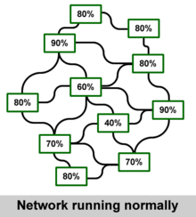
Why Debug?
SAS gives a lot of information.
SAS can often show what’s wrong and what’s expecting.
Prevent systemic failure.

Slide 3
Type of Programing Errors
Simple Errors:
  Syntax Errors.
  Order/Logical Errors.
  Understanding the SAS Log.
Macro Errors:
  Proper Macro Terminology and placement.
  Macro Options.

Slide 4
Listen to the Log!
The SAS Log will usually tell you what’s wrong.
The Log will frequently display relevant information.
Coding problems are labeled as either errors, warnings or notes in the log.

Slide 5
ERRORS!
Errors indicate that data may not have compiled or did so incorrectly.
Missing SemiColon:
proc print data = all
run;
Common Error Messages:
ERROR 202-322: The option or parameter is not recognized and will be ignored
ERROR: FILE= or TABLE= is required and must be specified

Slide 6
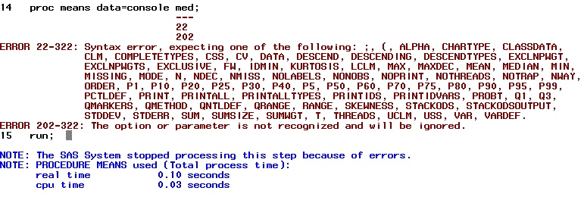
Succeeding Through Failure
SAS will often show you not only what’s wrong but what it’s expecting.

Slide 7

WARNINGS
Code may have compiled but did not executed properly.
Indicates that a data set was created but may be incomplete or empty.
Warning Example:

Slide 8
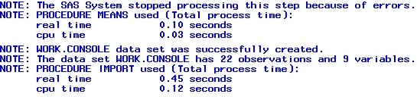
NOTES
Annotates progress when code is compiled and/or executed.
Can display good and bad information.
Two Notes Examples:

Slide 9
Debugging Macros
SAS has a dedicated processor just for macros.
They can be compiled even with errors.
Problems will often only show up after they are invoked.
%macro prt(r);
ods html close; ods html
proc print data = &r noobs;
run;
%mend;

Slide 10
Macro Quotations
The macro processor will only recognize macro variables that are in double quotes “ ”.
Applies when using the let statement and a title with a macro variable.
%let sys = Playstation;
data console;
set sega sony nintendo microsoft atari;
if system = "&sys";
title "Data for the &sys";
run;

Slide 11

Macro Options
There are activated and triggered macro options.
Triggered Options:
  Merror: Flags a reference to an nonexistent macro
  Serror: Flags symbolic errors within a macro

Slide 12
Macro Options
Activated Macro Options:
  MLogic: Shows start and end of macro executions, specifies parameters.
  MPrint: Shows at what point actual code is being executed.
  Symbolgen: Shows what the values of the macro variable “resolves” to.
To turn on/off options:
option mprint mlogic symbolgen;
option nomprint nomlogic nosymbolgen;

Slide 13
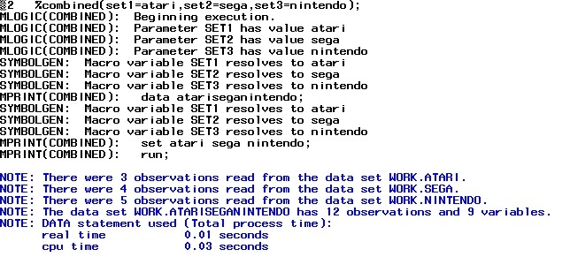
Macro Option Example

